Slide 1


Movie Data Analysis
by Sreeman
GCD May 2021 Batch : INSAID

Slide 2
Movie Dataset
We will Infer some interesting facts with this
DATA
Movie Data
Title
Genre
Director
Actors
Rating
Votes
Revenue
Runtime
Metascore

Slide 3
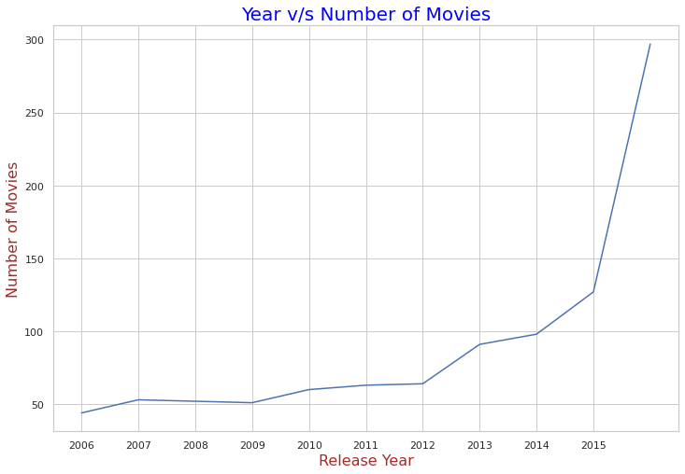
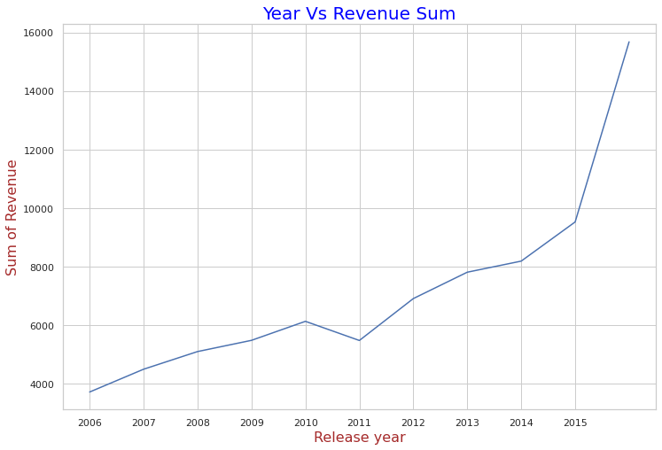
Year Wise Count and Revenue
Movies production and Revenue increasing year by year
Shows good sign for investment

Slide 4

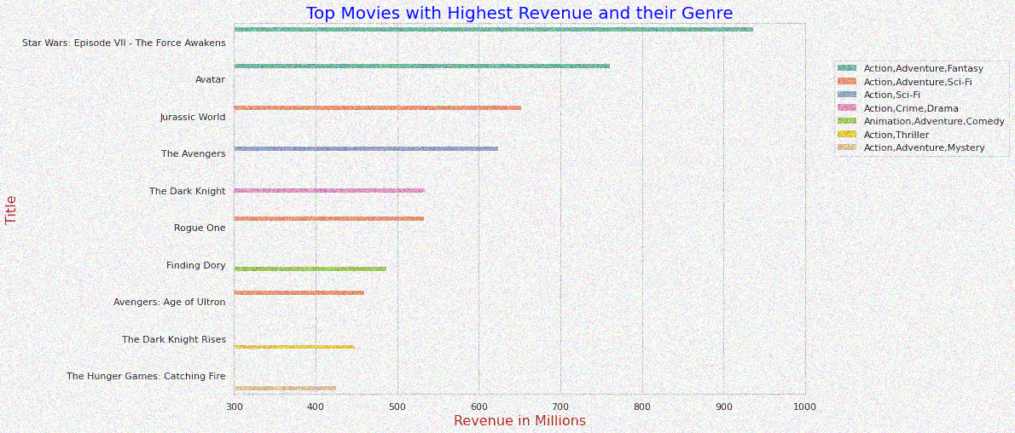
Top Revenue Movies

Slide 5
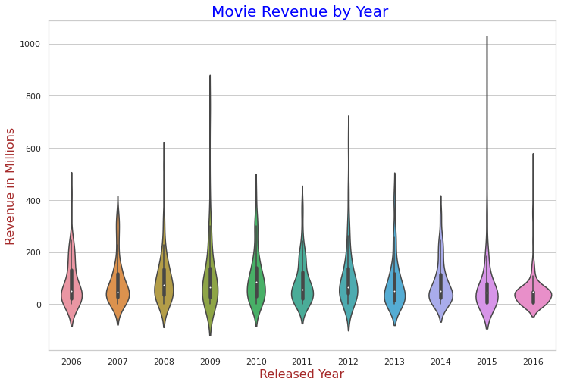
Movie Revenue by Year
Revenue Spread is Good All Over The Years
2009 and 2012 Revenue spread is more interesting.
Highest earning Movie Release in
. 2015 – Star Wars VII
. 2009-Avatar
. 2012 –Avengers
. 2016 – Rogue one

Slide 6
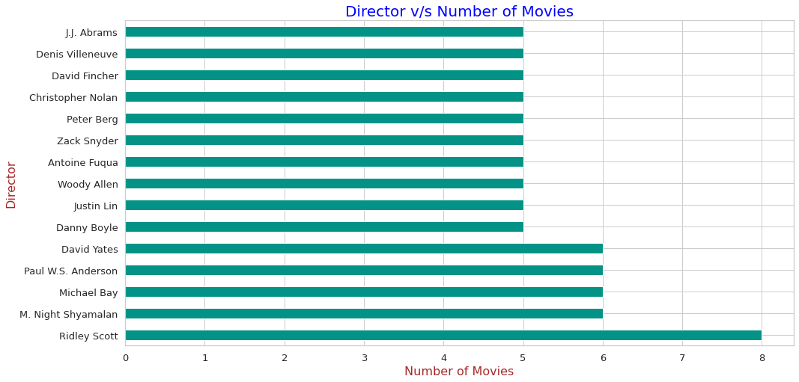
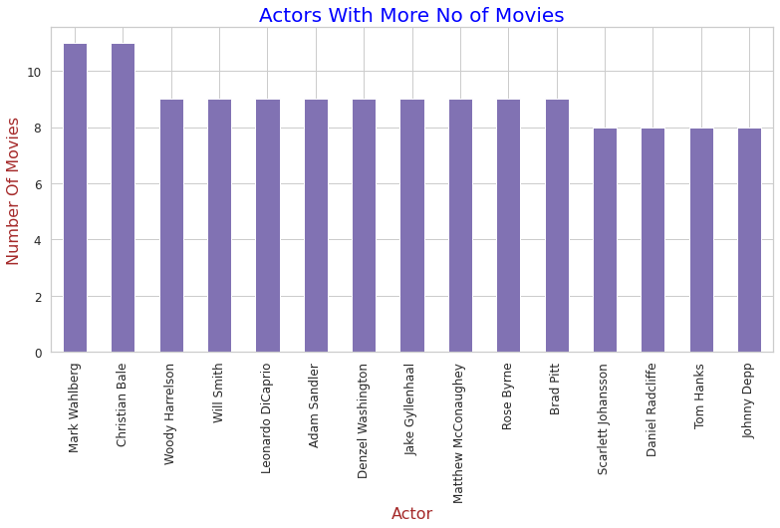
Directors and Actors Contribution
Quality Directors
Top Directors with Average Rating and Revenue is Higher
Nitesh Tiwari - 8.80 || JJ Abrams - 330m
Christoper Nolan - 8.68 || Christoper Nolan -303m
Makoto Shinkai - 8.60 || David Yates -270m
Oliver Nakache - 8.60 || Michael Bay -240m

Slide 7
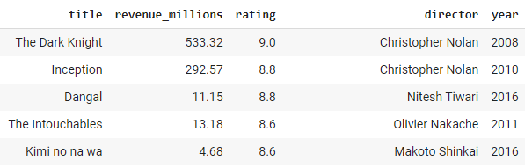
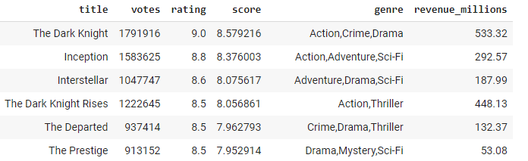
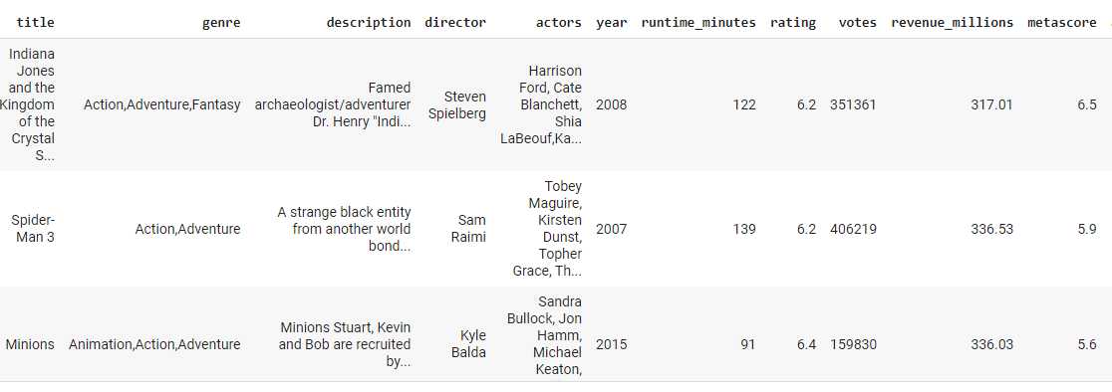
By Movie Ratings
Top Rating by Audience
Top Rating by Audience with More Votes
Rating is Less →
← But Revenue is more

Slide 8

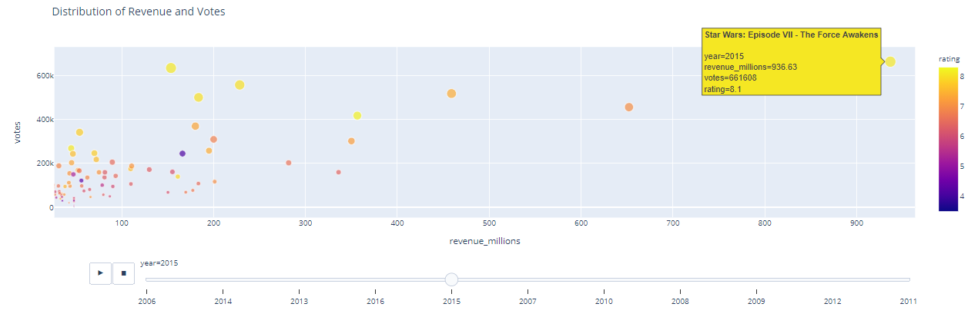
Distribution of Revenue and Votes
Some Cases Registered with Less Revenue even Ratings and Votes are Higher
Some of them are 2012 (Django Unchained) Year - 2014 (Interstellar) Year - 2006 (The Prestige,The Departed)

Slide 9

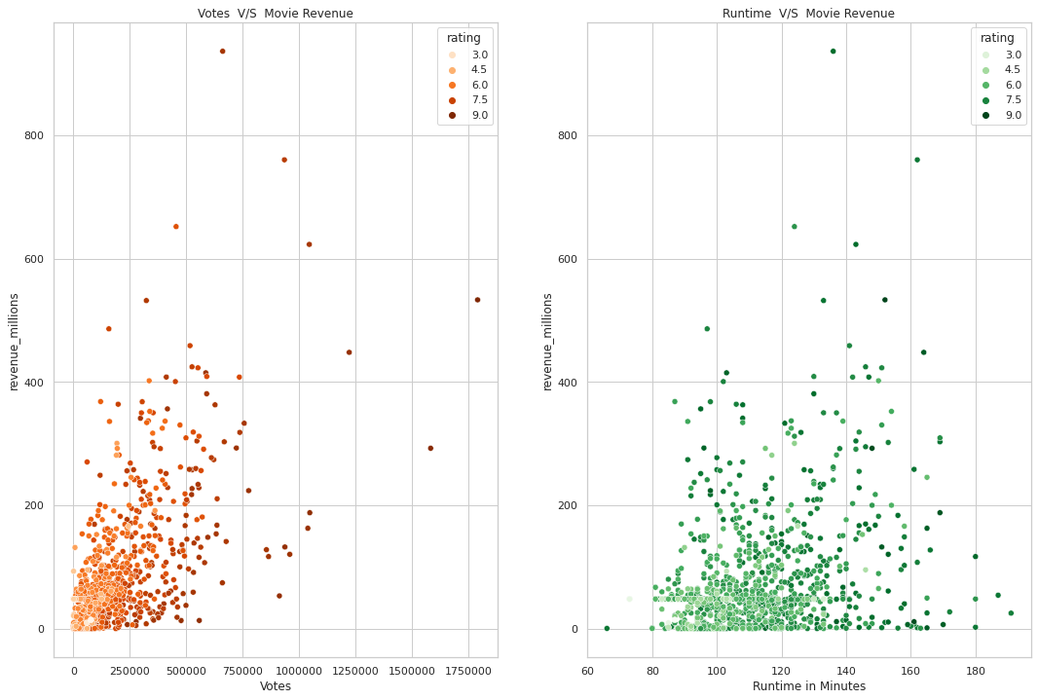
Votes, Runtime v/s Revenue
VOTES
Coefficient is positive,
Dots Concentrated
at Lower End
RUNTIME
100 to 140 Runtime
Return High Revenues
The darker spots shows us High Rated Movies

Slide 10
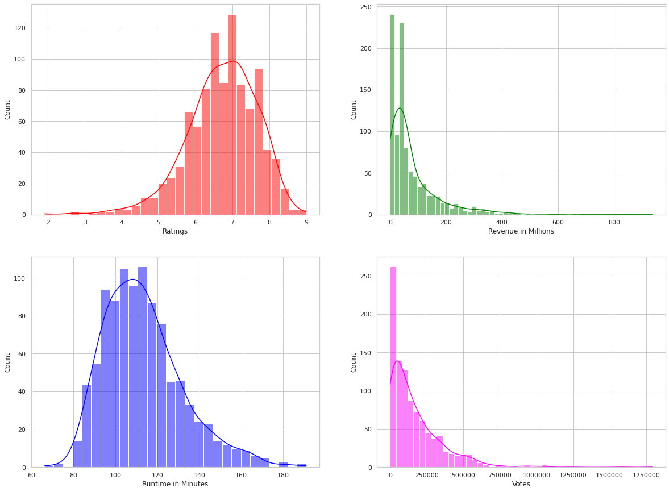
Distribution of Variables
Revenue
Revenue concentrated more below 150 million
Runtime
Most movies have a Runtime between 100 to 140
Ratings
Most frequent Ratings are between 6 to 8
Votes
More no of Votes concentrated at starting

Slide 11
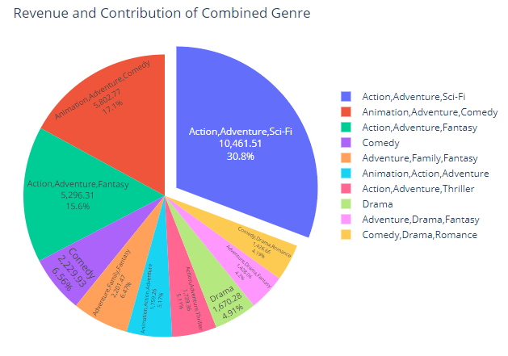
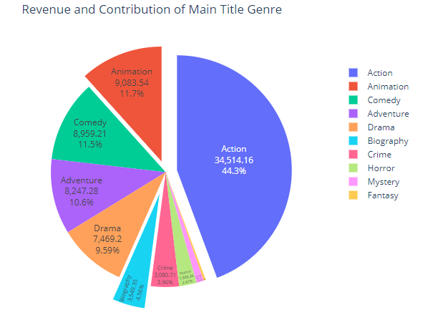
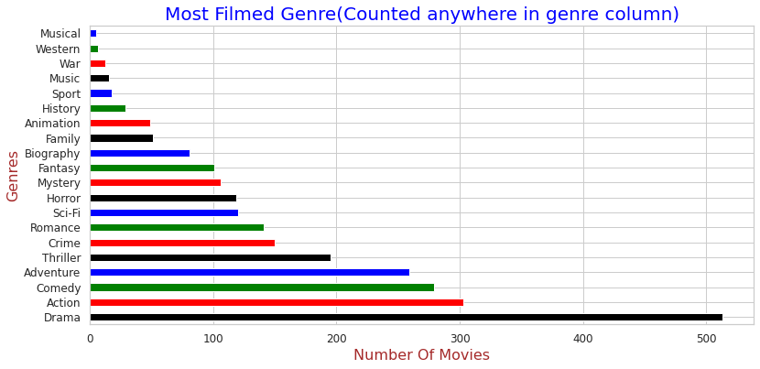
Spread of Genre

Slide 12
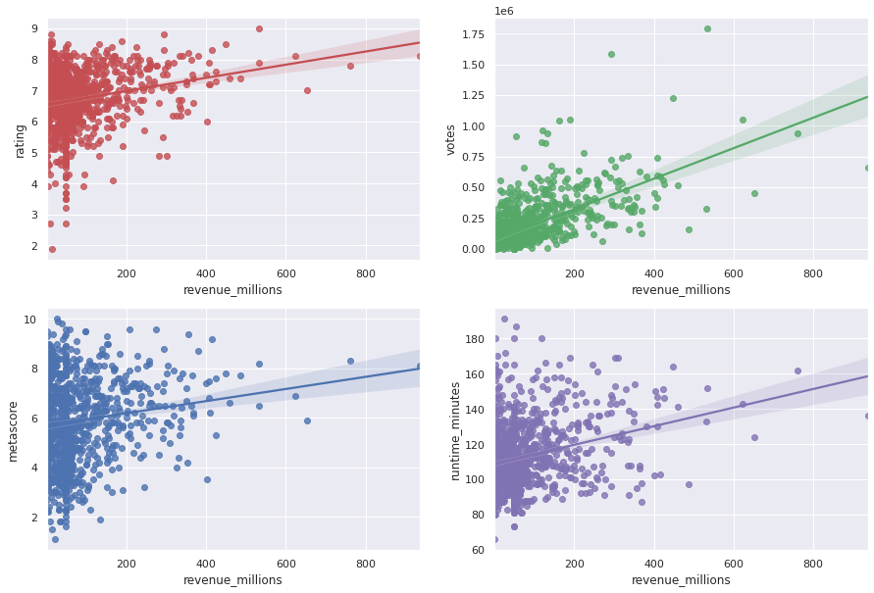
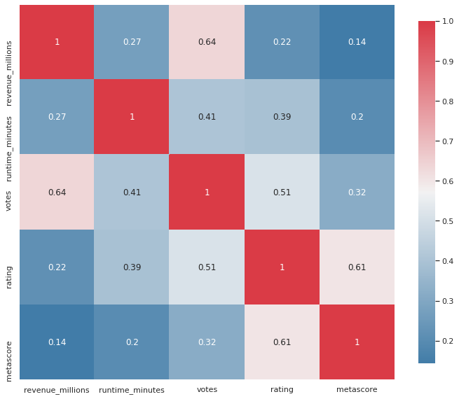
Properties Associated
Properties Associated with Revenue and other variables
The correlation between revenue and rating is 0.22. So vote average is not highly related to the revenue.
The correlation between revenue and runtime is 0.27. So runtime is not highly related to the revenue.
We can say that if the votes of movie is high then the revenue of the movie may be high.Correlation is 0.64
Metascore correlation with Revenue is very weak.

Slide 13

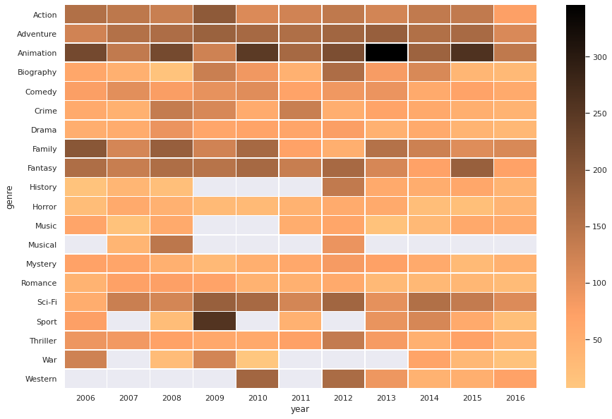
Genre Average Revenue by Year [Heat Map]
Note: Genre Anywhere in the Data is considered and Average revenue is taken
Animation, Action, Adventure, Comedy Movies average revenue is good over Years.
The same has been proven in Genre slides also.

Slide 14
Actionable Insights
The industry is good to invest . Top quality movies given for reference.
Action, Adventure, Comedy and Animation movies tend to be most profitable as per Genre Analysis.
The higher the Votes, the higher the Revenue (Most liked by audience).
The above mentioned Genre , Runtime (100 to 140 minutes) , The director and actor as per reference can be taken to build a successful movie.
The top and experienced directors, actors are suggested The Budget directors with more Revenue is also suggested

